Slide 1
Basics for Data Structures in R Ewy Mathé, Ph.D., Director of Informatics Division of Preclinical Innovation, NCATS/NIH https://ncats.nih.gov/preclinical/core/informatics

Slide 2
Basic R data structures
Element: character, numeric (double or integer), logic
> a <- 3
> a
[1] 3
Vector: contains elements of the same type
> a <- c(1,2,3)
> a
[1] 1 2 3
> a[1]
[1] 1
> a[2]
[1] 2
> typeof(a)
[1] "double"
> b=c("Metabolomics", "Rocks","!")
> b[3]
[1] "!"
> typeof(b)
[1] "character"

Slide 3
Basic R data structures
Element: character, numeric (double or integer), logic
> a <- 3
> a
[1] 3
Vector: contains elements of the same type
> a <- c(1,2,3)
> a
[1] 1 2 3
> a[1]
[1] 1
> a[2]
[1] 2
> typeof(a)
[1] "double"
> b=c("Metabolomics", "Rocks","!")
> b[3]
[1] "!"
> typeof(b)
[1] "character"

Slide 4
Basic R data structures: vector
Vectors: beware of mixing types!
> a=c(1.44,"A",2,"C")
> a
[1] "1.44" "A" "2" "C"
> typeof(a)
[1] "character"
> as.numeric(a)
[1] 1.44 NA 2.00 NA
Warning message:
NAs introduced by coercion
> a=c(1.44,A,2,C)
Error: object 'A' not found
> C <- 1:10
> C
[1] 1 2 3 4 5 6 7 8 9 10
> C[C < 3]
[1] 1 2
> C <- 10:1
> C
[1] 10 9 8 7 6 5 4 3 2 1
> which(C < 3)
[1] 9 10
> C[9:10]
[1] 2 1

Slide 5
Basic R data structures: matrix
Matrix: two dimensional structure (e.g. rows and columns) of the same type!
> a=c(1.44,"A",2,"C")
> a
[1] "1.44" "A" "2" "C"
> typeof(a)
[1] "character"
> as.numeric(a)
[1] 1.44 NA 2.00 NA
Warning message:
NAs introduced by coercion
> a=c(1.44,A,2,C)
Error: object 'A' not found
> C <- 1:10
> C
[1] 1 2 3 4 5 6 7 8 9 10
> C[C < 3]
[1] 1 2
> C <- 10:1
> C
[1] 10 9 8 7 6 5 4 3 2 1
> which(C < 3)
[1] 9 10
> C[9:10]
[1] 2 1

Slide 6
Basic R data structures: data frame
Data Frame: two dimensional structure (e.g. rows and columns) that different types! (it’s a generalization of a matrix, access is like a matrix)
> df <- data.frame(colA=1:3, colB=letters[1:3], colC=c(10,"A",200))
> df
colA colB colC
1 1 a 10
2 2 b A
3 3 c 200
> str(df)
'data.frame': 3 obs. of 3 variables:
$ colA: int 1 2 3
$ colB: Factor w/ 3 levels "a","b","c": 1 2 3
$ colC: Factor w/ 3 levels "10","200","A": 1 3 2
Beware of factors!!! By default, data.frame() will convert any characters vector to factors!!
Use stringsAsFactors=FALSE to suppress this behavior

Slide 7
Basic R data structures: data frame
> df <- data.frame(colA=1:3, colB=letters[1:3], colC=c(10,"A",200))
> df
colA colB colC
1 1 a 10
2 2 b A
3 3 c 200
> df$colC/2
[1] NA NA NA
Warning message:
In Ops.factor(df$colC, 2) : ‘/’ not meaningful for factors
> as.numeric(df$colC)/2
[1] 0.5 1.5 1.0
Beware of factors!!! By default, data.frame() will convert any characters vector to factors!!

Slide 8
Basic R data structures: data frame
> df <- data.frame(colA=1:3, colB=letters[1:3],
colC=c(10,"A",200),stringsAsFactors=FALSE)
> df
colA colB colC
1 1 a 10
2 2 b A
3 3 c 200
> str(df)
'data.frame': 3 obs. of 3 variables:
$ colA: int 1 2 3
$ colB: chr "a" "b" "c"
$ colC: chr "10" "A" "200"
> df$colC/2
Error in df$colC/2 : non-numeric argument to binary operator
> df$colC
[1] "10" "A" "200"
> typeof(df$colC)
[1] "character"

Slide 9
Basic R data structures: factors
Why do we care about factors? What if you have gender coded as 0/1, would you want them as factors?
Define factor:
Common error with numeric/factors
Change factor order (why?)
> a
[1] 1 2 3 4 5
> b <- as.factor(a)
> b
[1] 1 2 3 4 5
Levels: 1 2 3 4 5
> mode(b)
[1] "numeric"
> f <- factor(sample(1:100/100, 5))
> f
[1] 0.98 0.19 0.5 0.23 0.12
Levels: 0.12 0.19 0.23 0.5 0.98
> mode(f)
[1] "numeric"
> as.numeric(f)
[1] 5 2 4 3 1
> as.numeric(levels(f)[f])
[1] 0.98 0.19 0.50 0.23 0.12
> a <- as.factor(letters[1:3])
> a
[1] a b c
Levels: a b c
> a <- factor(a, levels=c("c","a","b"))
> a
[1] a b c
Levels: c a b
Look at your output for every step!!!!

Slide 10
Basic R data structures
Lists: has mixed data structures (e.g. numeric, character, matrices, etc…)
> mylist <- list("one"=TRUE, "two"=1:10, "three"=matrix(1:6,nrow=2))
> mylist
$one
[1] TRUE
$two
[1] 1 2 3 4 5 6 7 8 9 10
$three
[,1] [,2] [,3]
[1,] 1 3 5
[2,] 2 4 6
> str(mylist)
List of 3
$ one : logi TRUE
$ two : int [1:10] 1 2 3 4 5 6 7 8 9 10
$ three: int [1:2, 1:3] 1 2 3 4 5 6

Slide 11
Reading in Data
Do not use spaces in filenames. They are bad. Use underscores (“_”)
Read.csv(): reads in a comma-separated filename
Read.table: can define delimeters (e.g. space, comma, semi-colon, tab, etc)
Rio package: import()
These functions output a data.frame()!

Slide 12
RStudio/Rmd/Knitr
RStudio: Integrated Development Enterprise for R
R Markdown (Rmd): Uses Markdown (very simple markup language) that allows you to create documents with embedded R code very quickly.
Creates a log/notebook of your analytical experiments
Hallmark of reproducible research
https://rmarkdown.rstudio.com/authoring_basics.html
Knitr: generates an html or pdf report automatically (including running code if you want) by clicking the “knit” button in RStudio.
Let’s try it!`

Slide 13
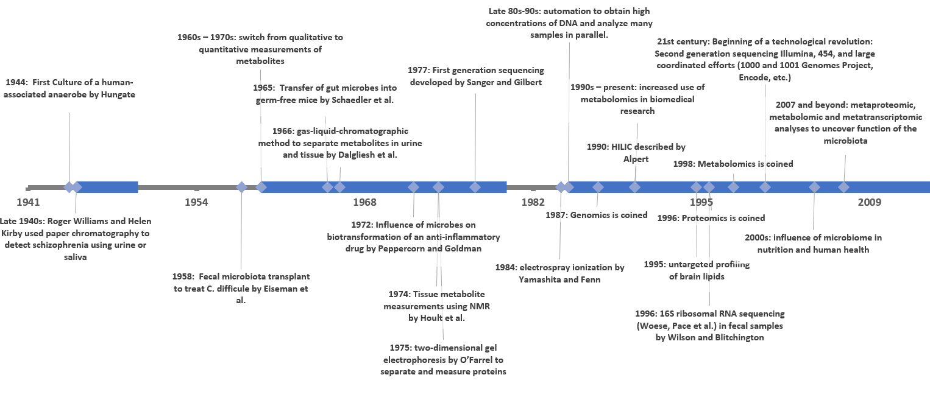
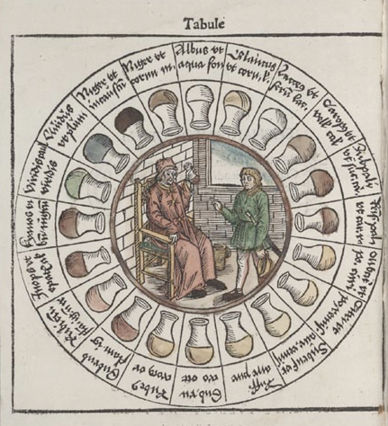
A Bit of History
Data and Informatics
Expansion of Technology Applications
Technology Revolution
Qualitative → Quantitation
1500 – 2000 BC China: ants used to detect diabetes
Middle ages (5th- 15th centuries): urine charts

Slide 14
Exposures, Lifestyle and Clinical Factors, Phenotypes
Metabolome
Transcriptome
Epigenome
The method you use to define relationships will give you complementary information and can yield new knowledge!
Lipidome
Microbiome
Proteome
Genome
Eicher et al., Metabolites 2020
Predicted relationships
Interpret relevant analytes in the context of biology, chemistry, and disease
Curated resources
Assess data quality and distribution
Evaluate analyte interrelationships
Associations with phenotype
Novel mechanisms?
Relevant (specific) biomarkers?
Improved annotations?
Biological Pathways
Disease Annotations
Chemical Annotations
Relevant meta-annotations

Slide 15
IntLIM: Capturing phenotype-specific associations
E(m|g) = β₁ + β₂g + β₃p + β₄(g:p)
R package with R Shiny web app and example datasets: https://github.com/ncats/IntLIM
Server access: https://intlim.ncats.io/
Siddiqui et al., BMC Bioinformatics 2018

Slide 16





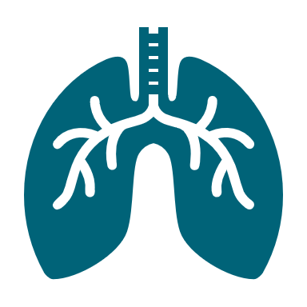
Application in identifying concordance between two asthma cohorts
GACRS (N=325)
Little concordance in metabolites measured between cohorts
CH₃
25,060 genes
489 metab.
Clinical covariates
OH
FEV₁/FVC
CH₃
CH₃
CH₃
OH
OH
OH
Pathway Analysis
CAMP (N=207)
IntLIM
CH₃
CH₃
CH₃
CH₃
20,048 genes
392 metab.
OH
OH
OH
Clinical covariates
OH
FEV₁/FVC
Little concordance in gene-gene, gene-metabolite, metabolite-metabolite pairs between both cohorts
Collaboration with Drs. Kelly and Lasky-Su
Notes:
Tara: I added this slide.

Slide 17
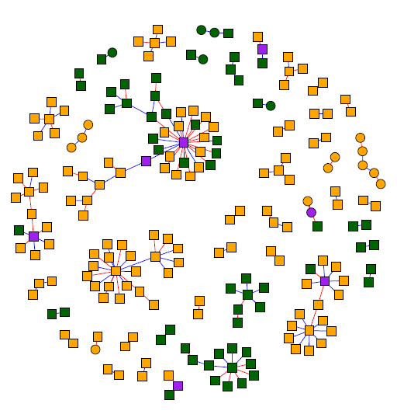
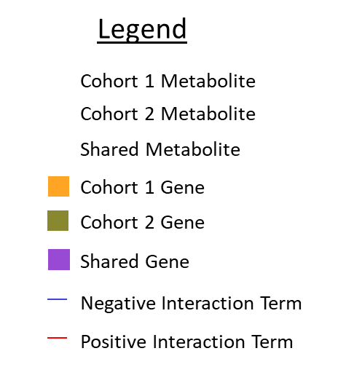
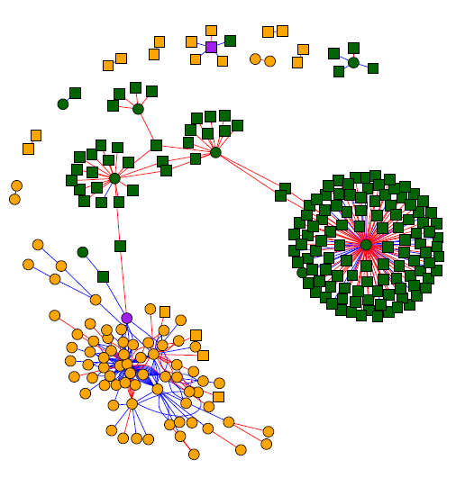
Concordance between GACRS and CAMP
PPARA Activates Gene Expression
Pathway Name | Enriched for IntLIM Analytes
 | GACRS | CAMP
Biosynthesis of unsaturated fatty acids | Y | Y
Class A/1 (Rhodopsin-like receptors) | Y | Y
Developmental Biology | Y | Y
PPARA activates gene expression | Y | Y
Regulation of lipid metabolism by Peroxisome proliferator-activated receptor alpha | Y | Y
Transcriptional regulation of white adipocyte differentiation | Y | Y
HDL Remodeling | Y | Y
Plasma Lipoprotein Remodeling | Y | Y
Plasma Lipoprotein Remodeling

Slide 18
RaMP – Relational Database of Metabolomic Pathways
Current Efforts
Semi-automated mapping of IDs with error capturing, supplemented by curation
Transparent curation process, with public database and app
~114K metabolites, 14K genes/enzymes, 55K pathways
New interactive web app to perform queries and pathway analyses
Up-to-date and comprehensive biological and chemical annotations of genes, proteins, and metabolites from multiple sources
Open-source, stand-alone usable database that can be queried and incorporated with other analysis tools.
Basis for improving pathway analysis methods
https://github.com/ncats/RaMP-DB

Slide 19
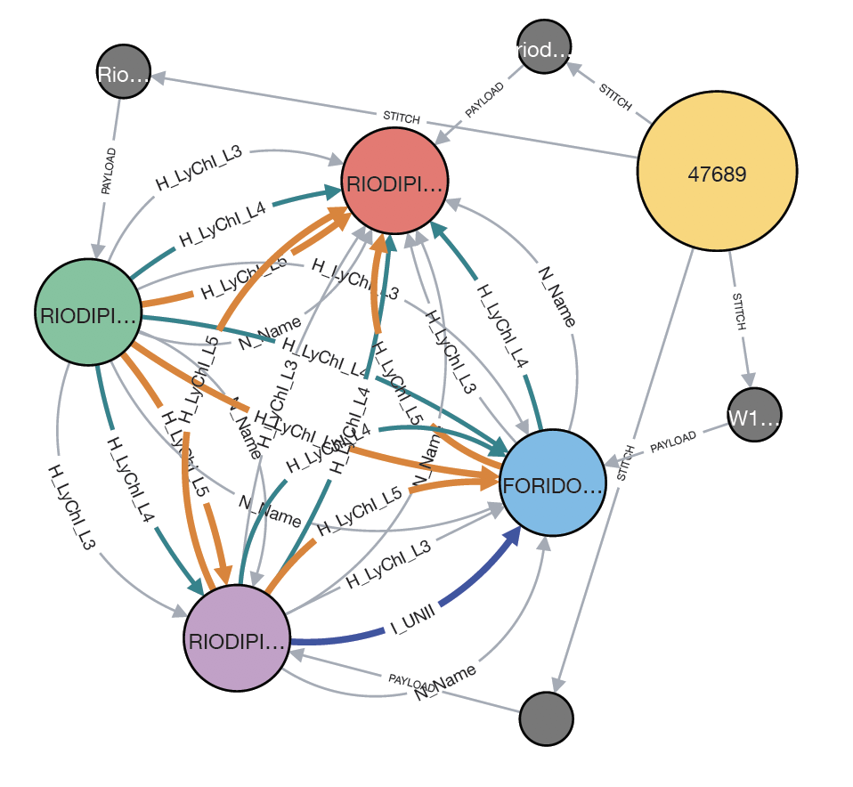
Stitcher – entity resolution
Goal: To create a framework to support comprehensive data integration
Group Node
Allows data from various sources to be ingested and “stitched” according to relationships between nodes (e.g. drugs, diseases, genes, proteins, etc.)
Current use cases:
neo4J serving Genetic and Rare Diseases
InXight (e.g. Approved drugs)
RaMP
Individual Source Data Nodes

Slide 20
Layered Chemical Identifier (LyChI)
Goal: Map chemical structures at different resolutions
Chemical structure standard (identifier) that represents the structure of a compound in 4 layers of hash codes
Layer 1 = Topology of structure (carbon skeleton)
Layer 2 = Topology + atom labels (tautomer insensitive)
Layer 3 = Topology + atom labels + bond order (stereo insensitive)
Layer 4 = Full structural resolution
Use Cases:
Indexing large chemical libraries
Curating bioactivity data
Hierarchical grouping of chemical structures (RaMP, G-SRS, Stitcher, ProbeDB, COMA, etc.)
LyChI is generated in 2 steps:
Chemical structure standardization
Hash code generation
https://github.com/ncats/lychi
Notes:
Rat liver microsome stability

Slide 21
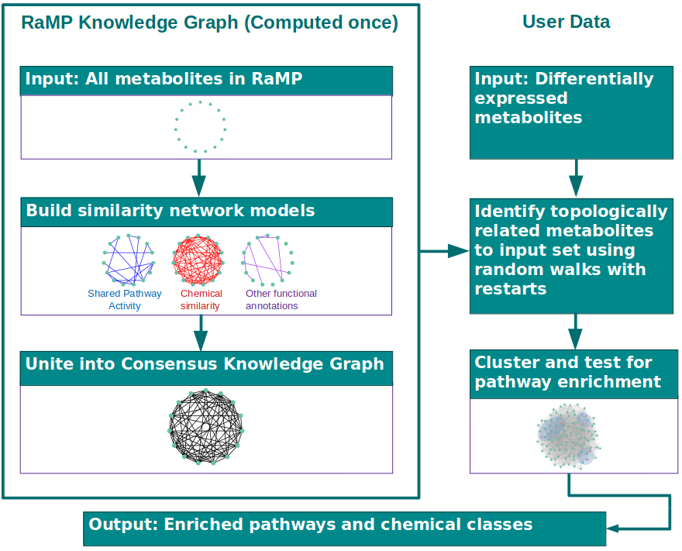
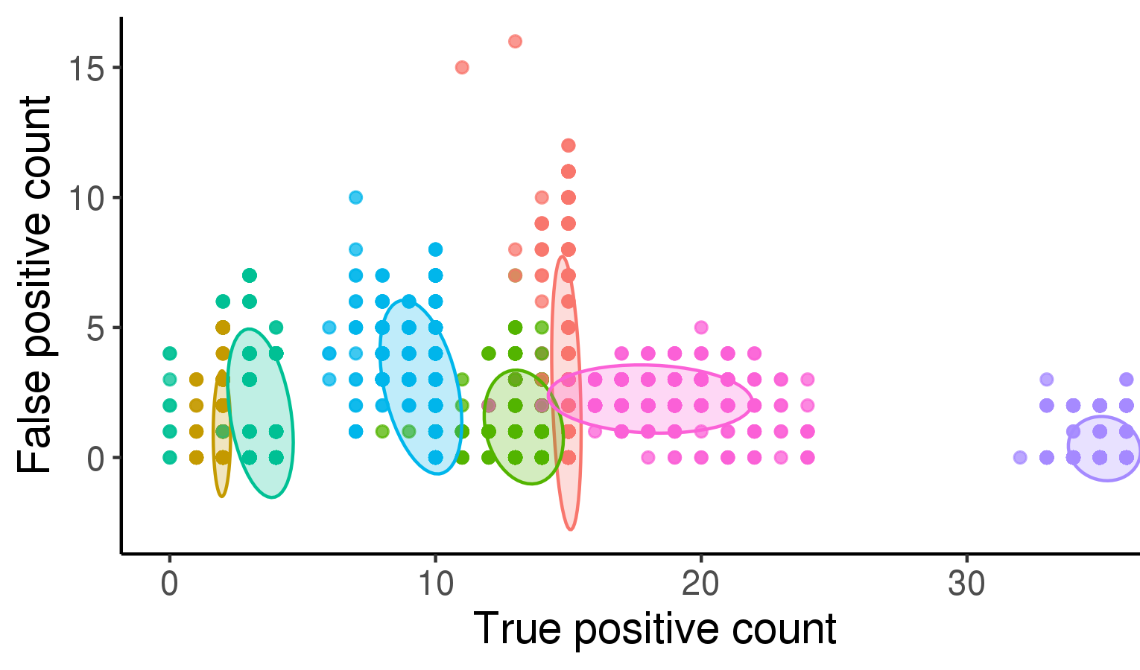
Using RaMP: improved pathway enrichment analysis
Goal: To evaluate the effect of database source use and pathway coverage on pathway enrichment
False positives in random/null data
test | MedianFP | MaxFP
FELLA | 54 | 108
Fishers | 1 | 9
Fishers_KEGGbg | 33 | 55
MS10_Fish | 2 | 10
MS10_KEGGbg | 33 | 56
MSEA | 36 | 44
NetGSA | 9 | 20
Ability to retrieve True positives in data subsets
Notes:
1 → 0.1 FDR

Slide 22
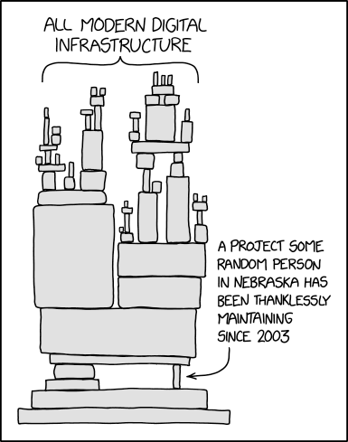
Informatics Challenges in Inferring meaning
Maintenance of resources and software/tools
Stitching together resources is not trivial
Agreements on standardization
Siloed fields of studies
There are lots of different options!
XKCD
Knowles, Mateen, Yehudi. Nat Comp Science March 2021

Slide 23
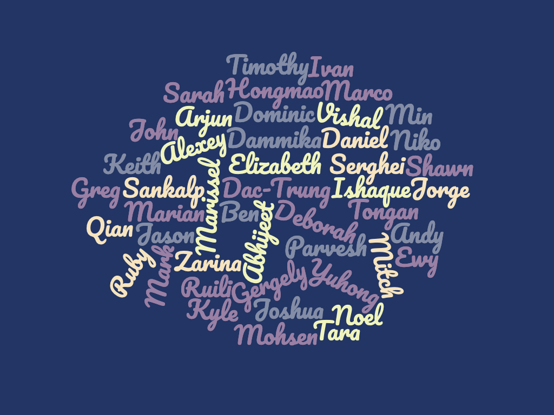
Informatics Core at NCATS
We are a very diverse group of 34 experts in bioinformatics, cheminformatics, clinical informatics, software developers, UI/UX researchers, data scientists, and project managers.
We collaborate with Informaticians and non-Informaticians across DPI, NCATS, NIH, and beyond.

Slide 24
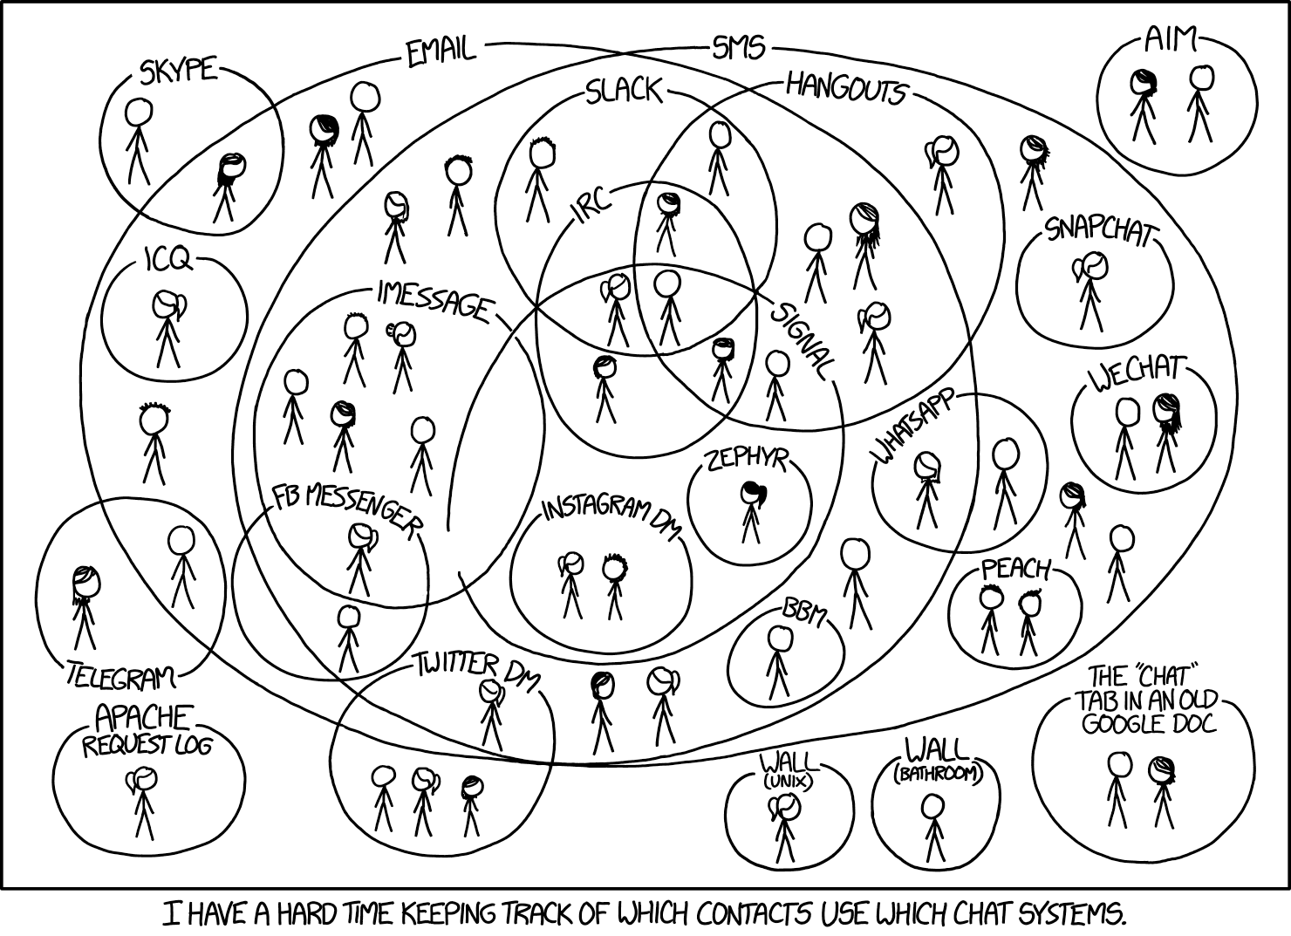
It’s All About Collaborative/Team Work
NCATS/NIH
Informatics and ITRB Teams
John Braisted
Christine Colvis
Poorva Dharkar
Tara Eicher
Danny Katzel
Sam Michael
Tim Mierzwa
Jorge Neyra
Trung Nguyen
Andy Patt (Poster 250)
Kyle Spencer
Noel Southall
Sarah Stemann
Amit Viraktamath
Ke Wang
Funding Sources
NCATS Intramural Program
Ohio State University
Haley Chatelaine
Emmanuel Hatzakis
Garrett Kinnebrew
Rachel Kopec
Cynthia Ramazani (BRD4-ISU)
Jalal Siddiqui
Kevin Ying
Brigham and Women's Hospital and Harvard Medical School
Su Chu
Mengna Huang
Rachel Kelly
Jessica Lasky-Su
Kevin Mendez
XKCD
https://ncats.nih.gov/preclinical/core/informatics/about
We’re hiring post-docs!!
NIH Graduate Partnerships Program

Slide 25

It’s All About Collaborative/Team Work
https://ncats.nih.gov/preclinical/core/informatics/about

Slide 26

Illuminating the Druggable Genome (NIH Common Fund)
Goal: to improve our understanding of the properties and functions of proteins that are currently unannotated and understudied.
Target Central Resource Database
Aggregates 78 resources
UI interface for TCRD Current Efforts
Expression data
Publications
Disease/pathway associations
GO annotation
Ligand/drugs
GWAS
IMPC phenotype
Target interactions
Tdark: Little is known
Tbio: Some biological functions are known
Tchem: Some chemical activity is known
Tclin: Approved drug is available
20,412 targets
19,683 diseases
266,944 ligands
Over 40 filters
Upload and save custom lists
Enhance usability of app
Incorporate new data generated by IDG
Integrate Pharos with other NCATS resources (COVID-19 ODP, GARD, etc.)
https://pharos.nih.gov
Collaboration with U. of New Mexico, Mount Sinai, EMBL-EBI, U. of Copenhagen, and U. of Miami.
Notes:
IMPC = murine phenotyping consortium

Slide 27
Curation process: ID Mappings in RaMP
ID A
Metabolite (1)
ID A
Metabolite (1)
ID A
Metabolite (1)
ID B
ID B
ID B
ID C
ID C
ID C
ID D
Metabolite (2)
Metabolite (2)
ID D
Metabolite (2)
ID D
ID E
ID E
ID E
ID F
Metabolite (3)
Metabolite (3)
ID F
Metabolite (3)
ID F
ID C
ID C
What if ID C mapping to ID F is wrong?

Slide 28
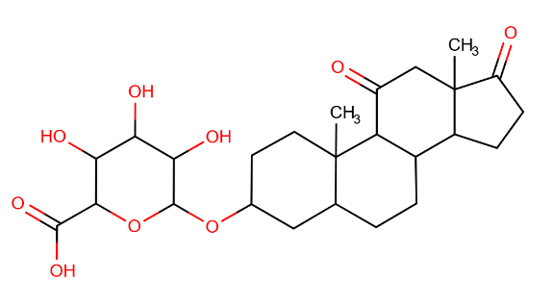
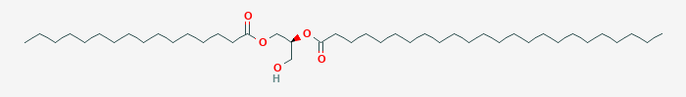
Erroneous ID Mappings in RaMP
Two completely different structures are mapping to the same pubchem id
hmdb:HMDB0010338
ID A
Metabolite (1)
ID B
11-Oxo-androsterone glucuronide
ID C
Problem
Association.
RAMP_C_000072454
ID F
Metabolite (3)
pubchem:53478031
DG(16:0/24:0/0:0)
ID C
OK
hmdb:HMDB0007122
Notes:
Completely wrong structure

Slide 29
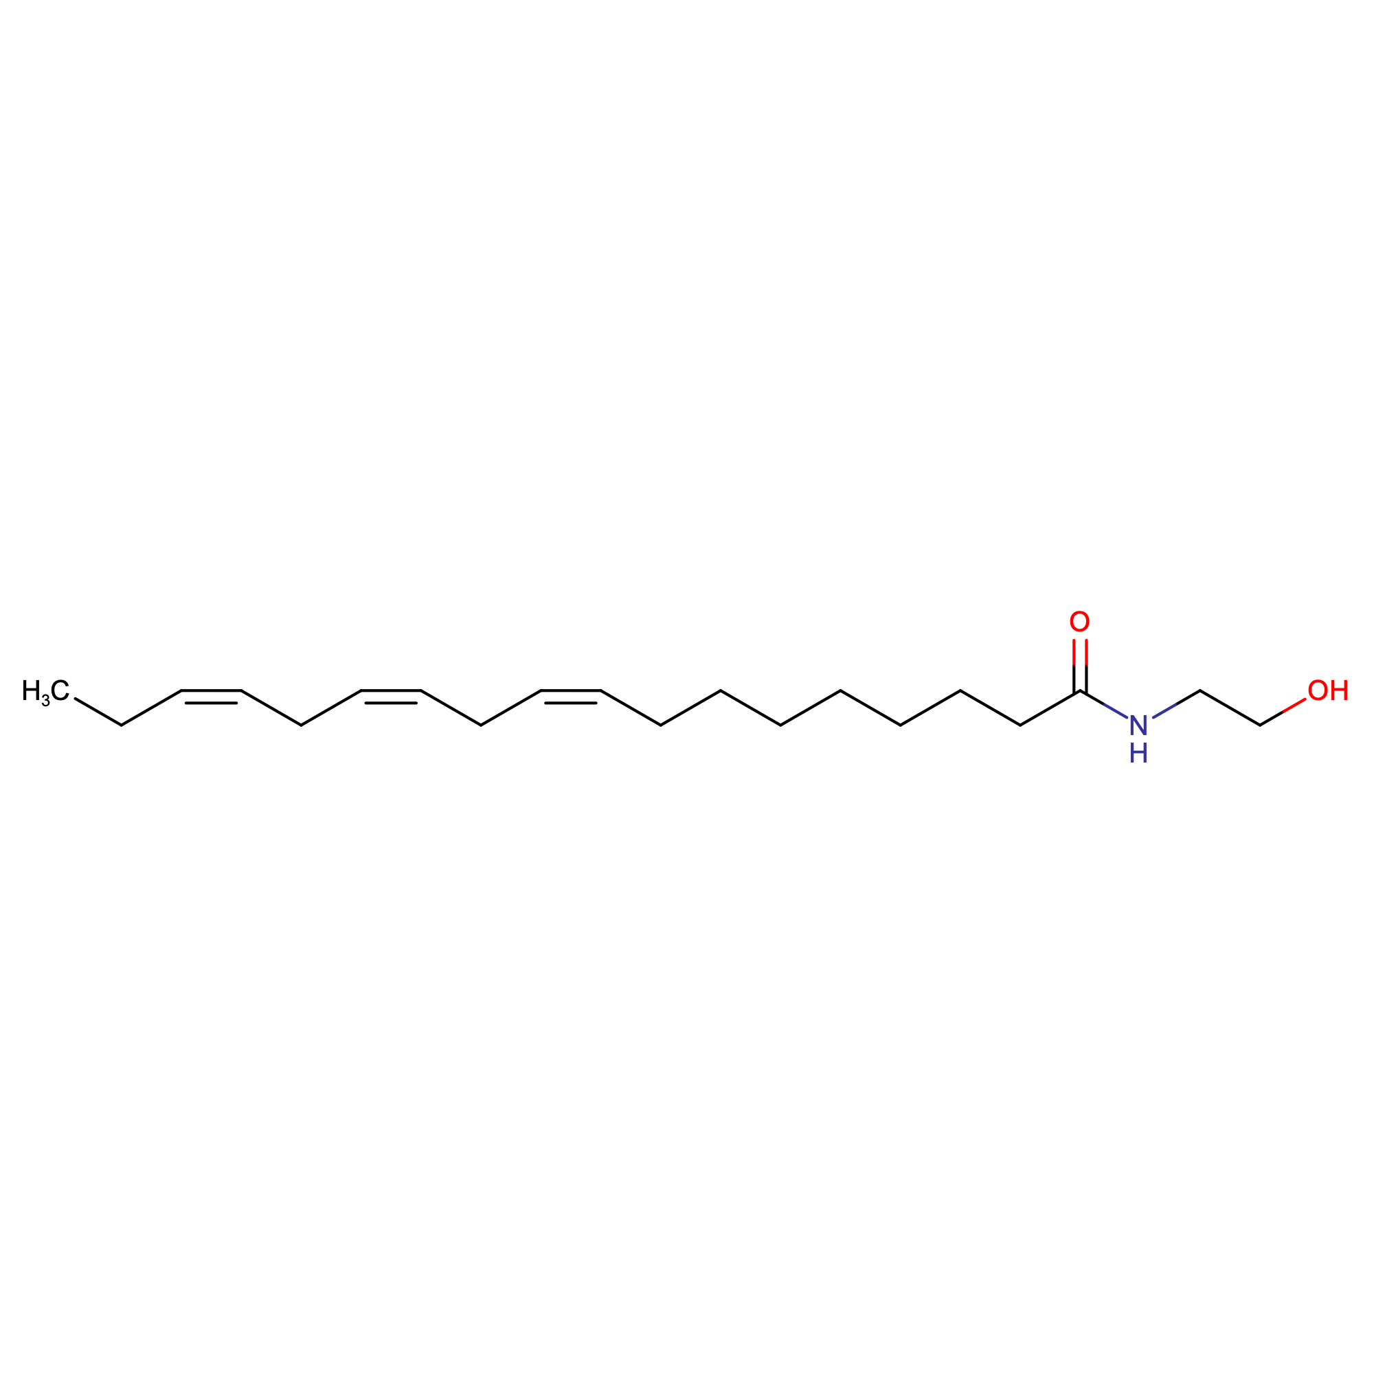
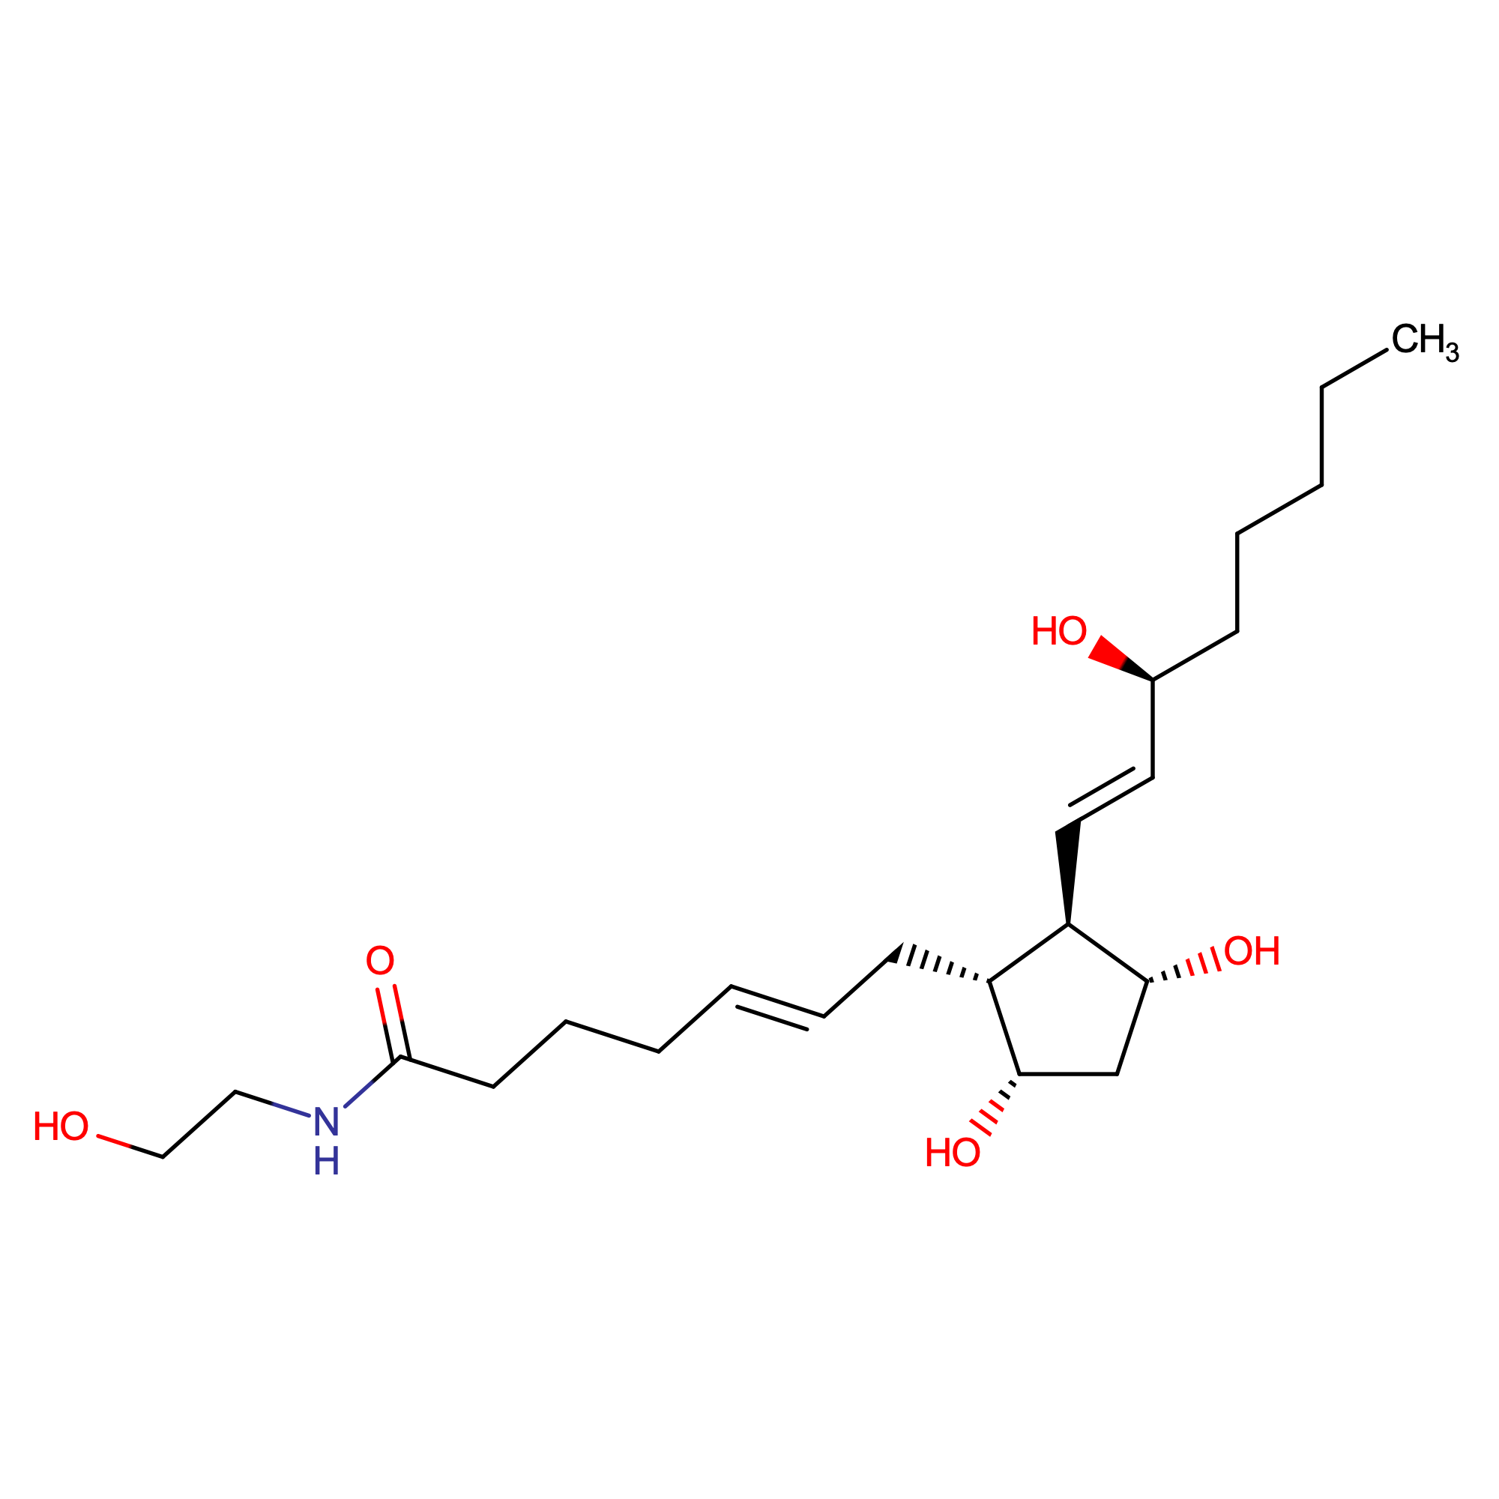
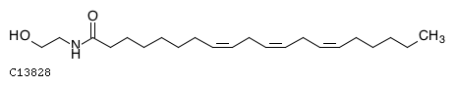
Erroneous ID Mappings in RaMP
Two ethonolamide-based structures map to the same KEGG id
RAMP_C_000044109
Alpha-Linolenoyl ethanolamide
HMDB0013624
pubchem:5283449
kegg:C13828
Problem Shared
Association at HMDB
HMDB0013628
PGF2a ethanolamide
pubchem:53481911
Notes:
KEGG does not connect C13828 with a pathway.
Also the issue of stale mappings

Slide 30
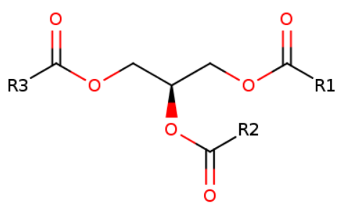
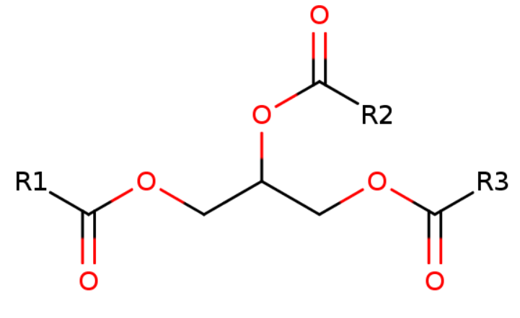
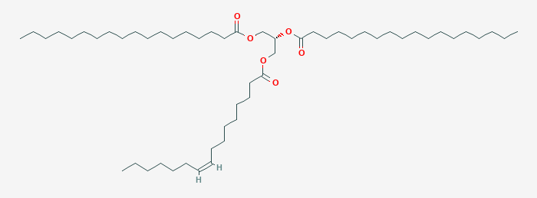
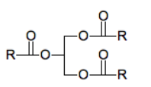
Fuzzy aggregation is acceptable if metabolites are from the same class
118 of 125 HMDB TG records map over to the generic kegg:C00422 TG
HMDB does not map to these two generic chebi ids.
WikiPathways uses the generic chebi ids in a few cases.
triglyceride
chebi:17855
chebi:64615
RAMP_C_000114913
kegg:C00422
pubchem:9544049
TG(16:1(9Z)/18:0/18:0)[iso3]

Slide 31

FAIR (Findability, Accessibility, Interoperability, Reuse) Wilkinson et al. Sci Data 2016
Requires standardization:
Sample collection/storage
Data acquisition (instrumentation, reagents, etc.)
Molecular data reporting (standards in naming of analytes, their annotations, etc.)
Meta-data reporting (information on sample collection/storage, sample annotations, etc.)
Data processing and reporting (software, version, parameters, etc.)
Each field is largely siloed:
Standards in annotations are data-type dependent
Different fields have different requirements in data reporting
Formats are data-dependent
Many options to choose from!
Requires domain knowledge and frequent updating
Requires communication across fields

Slide 32
RaMP 2.0
 | Total | HMDB | KEGG* | Reactome | WikiPathways
# Distinct Metabolites | 114,518 (+790) | 114,222 | 4,684 | 2,131 | 3,249
# Distinct Genes/Enzymes | 13,927 (-1,490*) | 5,702 | 1,680 | 11,437 | 12,188
# Distinct Pathways | 55,215 (+3,689) | 48,682 | 241 | 2,421 | 1,112
# Metabolite-Pathway Mappings | 408,232 (+338,567) | 369,210 | 1989 | 28,157 | 10,865
# Gene-Pathway Mappings | 463,447 (-3,143*) | 208,613 | 5,323 | 121,076 | 53,837
* From HMDB

Slide 33
RaMP 2.0 Chemical Properties
 | Total Distinct Compounds* | HMDB | ChEBI | LipidMaps
Chemical Properties§ | 115,958 | 113,569 | 9,354 | 651
Chemical properties include, chemical information source, chemical source identifier, isomeric SMILES, InCHI key, InCHI, molecular weight, monoisotopic mass, common name, molecular formula
* Distinct InCHI Keys
§ Chemical properties are only captured for compounds referenced within RaMP

Slide 34
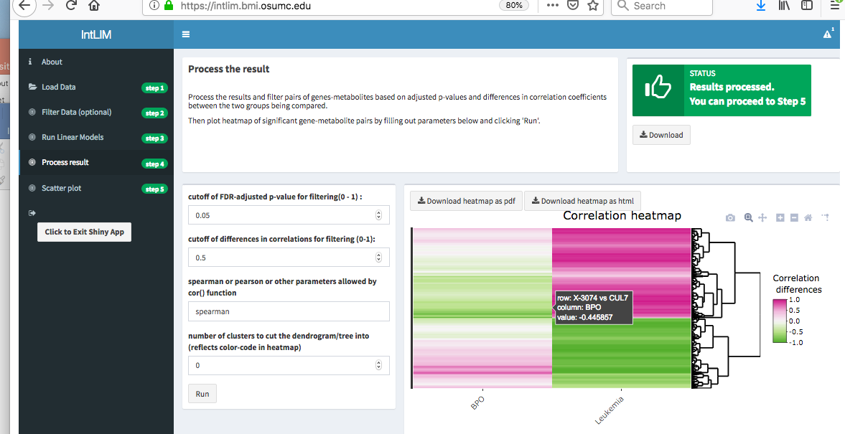
IntLIM Interactive Web Application

Slide 35
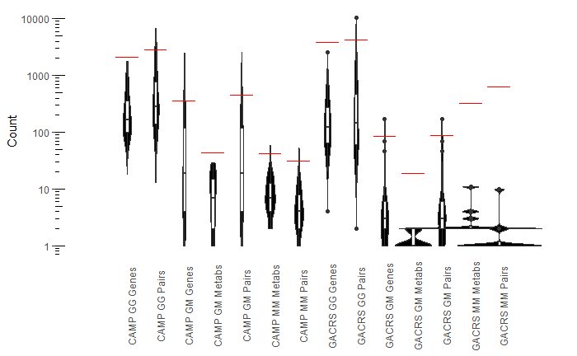
Robustness of significant pairs uncovered
Count of analyte associations is significantly higher in original data than in permuted data (100 iterations)
Permuted Data
Original Data

Slide 36
Predicted Relationships: Numerical Integration
Pairwise-associations of analytes (e.g. linear modeling, correlation-based methods)
Consistent analyte associations across all samples (e.g. canonical correlations)
Phenotype-specific associations
Indirect effects of an analyte on a given phenotype (e.g. mediation analysis)
Dimensionality reduction (e.g. WGCNA, SmCCNet)
Reduce your data to modules that each contain related analytes
Relate modules to phenotype, biological pathways, or other known information (e.g. other public datasets)
Networks
Requires definition of nodes and edges
Quantify characteristics of the network (node degree, between centrality)
Identify modules (Louvain, MuNCut) and relate them to known information
Compare networks
The method you use to define relationships will give you complementary information and can yield new knowledge!
Notes:
Here, I’m making the assumption is to understand associations between your input molecules or data
Mediation: a microbe could affect the host through some metabolite

